Slide 1


Slide 2
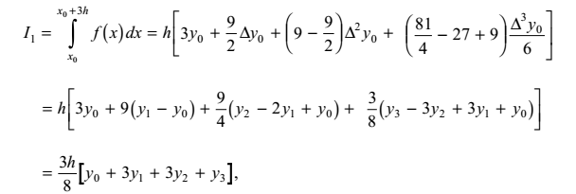

Numerical Methods
National University of Science and Technology, Islamabad

Slide 3
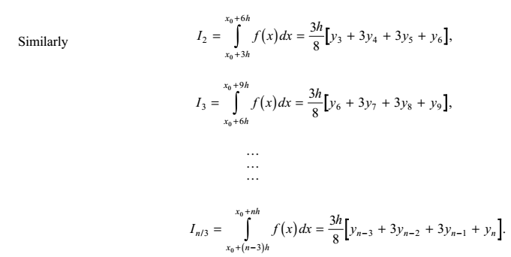
Numerical Methods
National University of Science and Technology, Islamabad

Slide 4
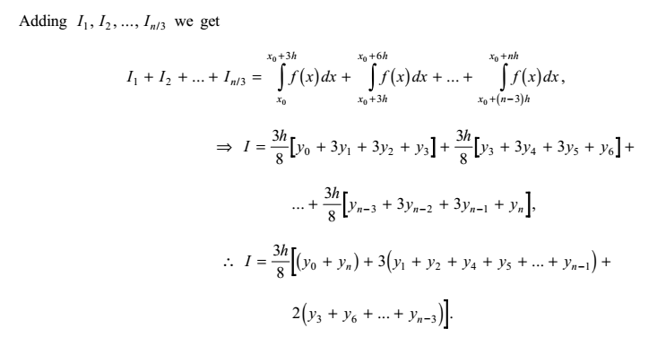
Numerical Methods
National University of Science and Technology, Islamabad

Slide 5
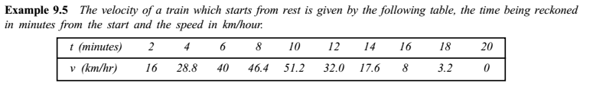
Numerical Methods
National University of Science and Technology, Islamabad

Slide 6
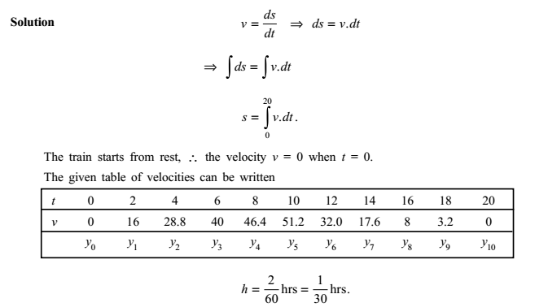
Numerical Methods
National University of Science and Technology, Islamabad

Slide 7
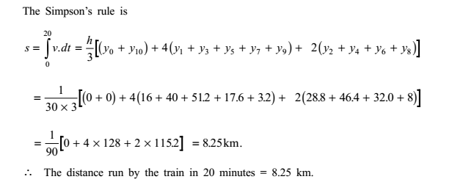
Numerical Methods
National University of Science and Technology, Islamabad

Slide 8

Numerical Methods
National University of Science and Technology, Islamabad

Slide 9
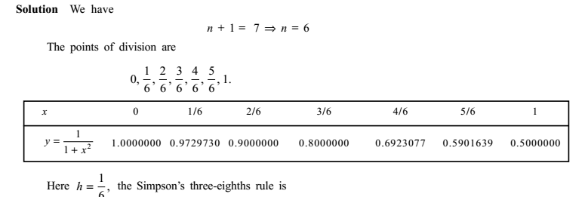
Numerical Methods
National University of Science and Technology, Islamabad

Slide 10
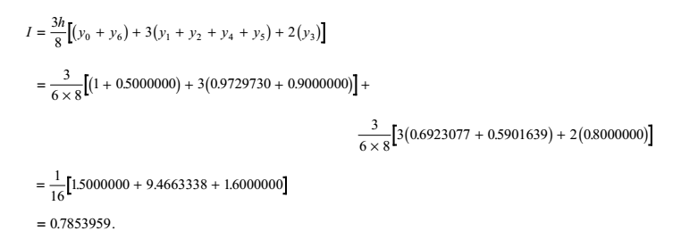
Numerical Methods
National University of Science and Technology, Islamabad

Slide 11
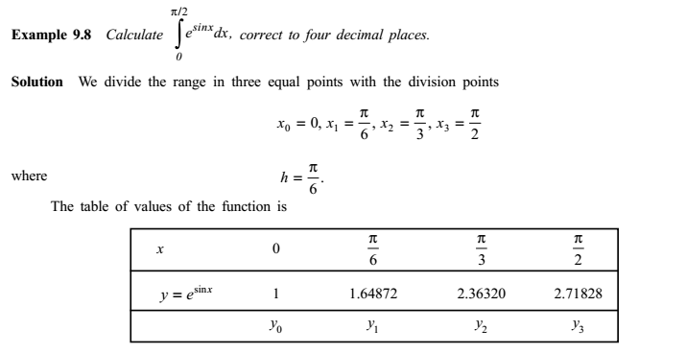
Numerical Methods
National University of Science and Technology, Islamabad

Slide 12
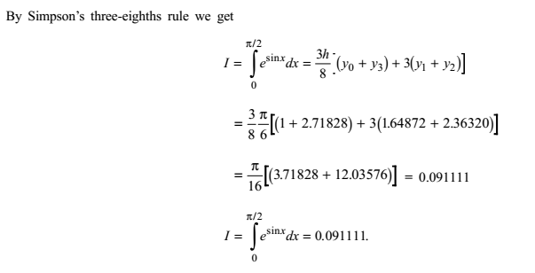
Numerical Methods
National University of Science and Technology, Islamabad

Slide 13
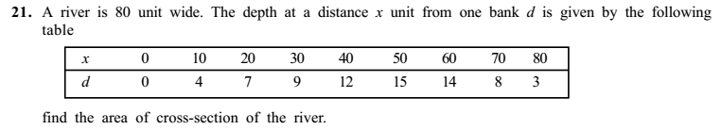
Numerical Methods
National University of Science and Technology, Islamabad

Slide 14
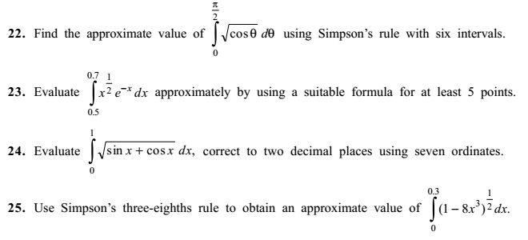
Numerical Methods
National University of Science and Technology, Islamabad

Slide 15

Numerical Methods
Note: All area related problems (definite integrals) in which interval of integration is
divided into intervals multiple of 3 can be attempted by Simpson’s 3/8 rule.
National University of Science and Technology, Islamabad

